Slide 1


RAG & LANGCHAIN LAB: ASK ELEVEN MADISON PARK RESTAURANT

Slide 2




Project Overview
In this project, we'll build an AI assistant that can answer questions about a specific topic (the Eleven Madison Park restaurant) based on provided documents in a database.
This technique is called Retrieval-Augmented Generation (RAG).
Input
Output
Eleven Madison Park serves a fully plant-based menu, using no animal products.
What kind of food does Eleven Madison Park Restaurant serve?
© All rights reserved for Dr. Ryan Ahmed @Stemplicity Inc.
Search
Fetch
Eleven Madison Park Data

Slide 3

Key Learning Outcomes
Understand the core principles of Retrieval-Augmented Generation (RAG).
Use LangChain to streamline and orchestrate the RAG workflow.
Load, preprocess, and split text documents for optimal performance.
Generate high-quality embeddings using OpenAI models.
Store and search embeddings efficiently with ChromaDB as your vector database.
Build a powerful Retrieval-Based Question Answering (QA) chain using LangChain.
Design an interactive Gradio UI that displays answers along with source citations for transparency.
© All rights reserved for Dr. Ryan Ahmed @Stemplicity Inc.

Slide 4

Summary
Retrieval-Augmented Generation (RAG) was presented as a robust approach for combining retrieval systems with generative language models to deliver accurate, context-aware outputs.
An end-to-end RAG pipeline was developed using LangChain for orchestration, OpenAI for embeddings, and ChromaDB for efficient vector search.
Key implementation techniques such as document preprocessing, embedding generation, and vector storage were demonstrated following best practices.
You can build powerful AI applications easily and quickly using an interactive Gradio interface which was designed to showcase answers alongside cited sources, ensuring transparency & enhancing user trust.
© All rights reserved for Dr. Ryan Ahmed @Stemplicity Inc.

Slide 5

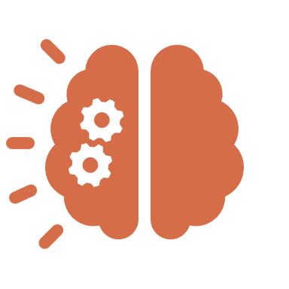
Retrieval Augmented Generation (RAG)
RAG is a technique that combines retrieval-based systems with generative AI models.
It's commonly used to enhance the capabilities of LLMs by integrating external knowledge sources.
R
A
G
Prompt
Retriever
Prompt + Context
Output
User
Fetch
LLM
Search
© All rights reserved for Dr. Ryan Ahmed @Stemplicity Inc.
Database (context)
R Lookup the external source to retrieve the relevant information
A Add the retrieved information to the user prompt
G Use LLM to generate a response to the user prompt with the context

Slide 6
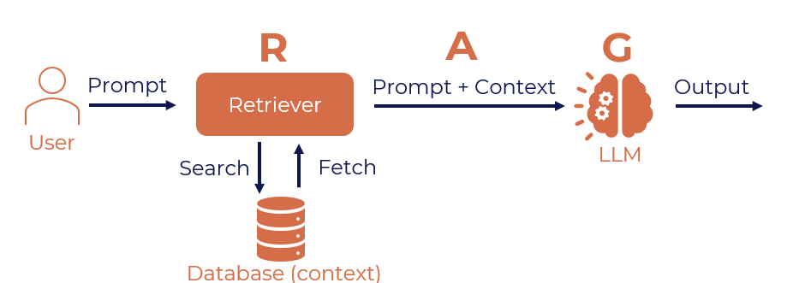
Retrieval Augmented Generation (RAG)
The user writes a prompt or a query that is passed to an orchestrator.
The orchestrator sends a search query to the retriever.
Retriever fetches the relevant information from the knowledge sources and sends back.
The orchestrator augments the prompt with the context and sends it to the LLM.
LLM responds with the generated text which is displayed to the user via the orchestrator.
© All rights reserved for Dr. Ryan Ahmed @Stemplicity Inc.

Slide 7
Why use RAG?
Accurate Responses: Combines retrieval with generative AI to ground outputs in factual data, minimizing errors.
Up-to-Date Information: Dynamically accesses the latest content, ensuring relevance without retraining.
Cost-Efficient:
Reduces computational burden by relying on retrieval for context, cutting costs.
Customizable:
Easily tailored to specific industries and domains with custom datasets.
Explainable:
Increases trust by surfacing the data sources behind generated responses.
© All rights reserved for Dr. Ryan Ahmed @Stemplicity Inc.

Slide 8
Fine-tuning Vs. RAG
Aspect | Fine-Tuning | Retrieval-Augmented Generation (RAG)
What It Is | Training the base model (e.g., GPT) on a specific dataset to adapt it to a particular use case. | Combines GPT's language generation with a retrieval mechanism that fetches external information.
How It Works | Provide a labeled dataset tailored to your task. | A document or database is indexed using a vector database.
 | Retrain the model using this data, updating its weights. | When queried, retrieves the most relevant chunks using similarity search.
 |  | GPT generates responses by combining retrieved information with general knowledge.
Use Case | Useful for well-structured, high-quality datasets and niche understanding. | Ideal for applications requiring up-to-date or domain-specific knowledge without retraining.
 | Requires compute resources and training expertise.
Advantages | Deeply integrates the knowledge from the dataset. | Does not require retraining the model; integrates external knowledge.
 |  | Easier to maintain; data can be updated without modifying the model.
 |  | Cost-effective compared to fine-tuning.
Drawbacks | Expensive and time-consuming. | Relies on the quality of the retrieval system and indexed data.
 | Locks the model into a specific knowledge set, limiting flexibility for dynamic or broad queries. | Retrieval may fail if documents are poorly indexed or irrelevant data is fetched.
© All rights reserved for Dr. Ryan Ahmed @Stemplicity Inc.

Slide 9

What is LangChain?
LangChain is a framework designed to help developers build applications using large language models more effectively.
Instead of just sending one prompt and getting one reply, LangChain lets you chain together different components (like prompts, memory, tools, retrieval from documents, etc.) to build more complex, smarter apps.
© All rights reserved for Dr. Ryan Ahmed @Stemplicity Inc.

Slide 10
LangChain Features
Chains
You can link together multiple steps or calls to a model.
Example: Ask a question → Search Wikipedia → Summarize → Translate the summary.
Agents
LLMs that decide which tools to use and when.
Think of them like smart assistants that can use calculators, databases, or search engines when needed.
Tools/Plugins
Connect your LLM to Google search, Python code execution, file reading, etc.
Example: “What’s 347 * 65?” → LLM uses a calculator tool to answer accurately.
Memory
Keeps track of the conversation history or user preferences.
Makes interactions more contextual and human-like.
Retrieval-Augmented Generation (RAG)
Connect LLM to your documents (databases, websites).
It retrieves relevant info from them to answer questions accurately.
© All rights reserved for Dr. Ryan Ahmed @Stemplicity Inc.

Slide 11
What is Embedding?
In the context of Large Language Models (LLMs), embedding refers to a way of representing words, phrases, sentences, and documents as dense vectors of numbers.
These vectors capture the semantic meaning of the text, allowing the model to understand and work with language more effectively.
© All rights reserved for Dr. Ryan Ahmed @Stemplicity Inc.
Vector Embedding
Input Text:
“Queen”
Embedding Model
 | [ | 9, | 7, | 8 | ]
https://www.cs.cmu.edu/~dst/WordEmbeddingDemo/tutorial.html

Slide 12
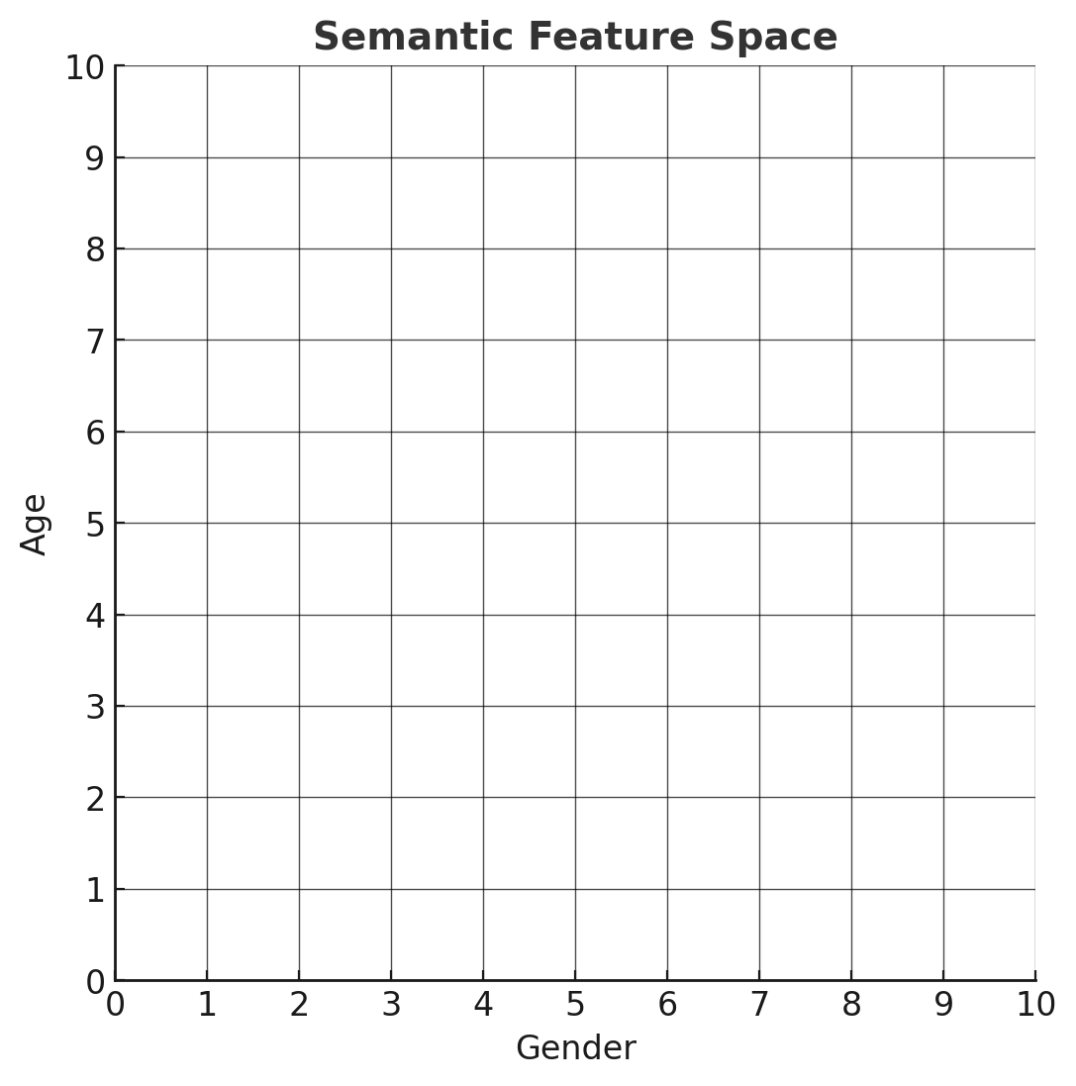
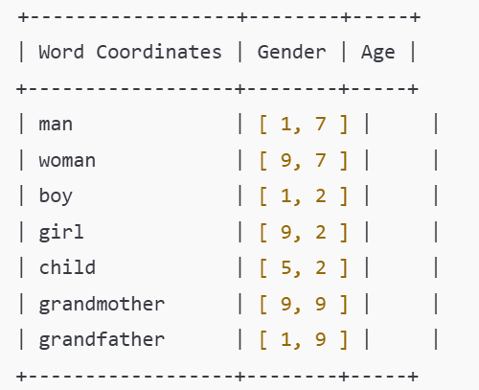
Embedding Example
Assume that we want to represent the words “man”, “woman”, “boy”, and “girl” on a semantic feature space.
On the X-axis, we have “gender”, and on the Y-axis, we have “Age”. These are called semantic features.
Note that two words refer to males, two to females, two to adults, and two to children.
grandfather
grandmother
man
woman
© All rights reserved for Dr. Ryan Ahmed @Stemplicity Inc.
boy
child
girl

Slide 13
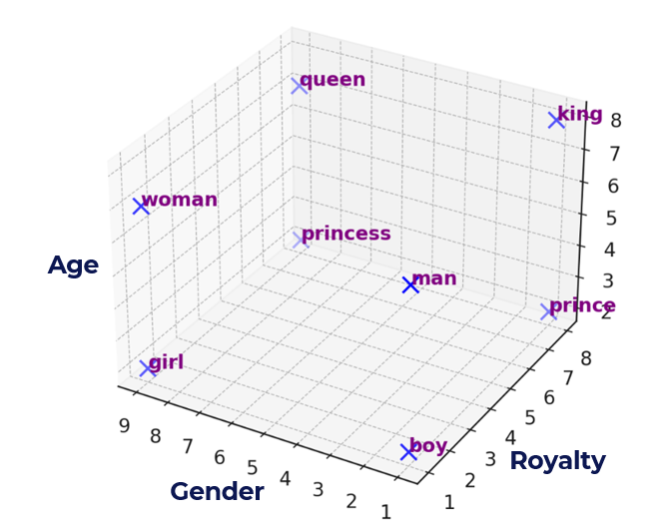
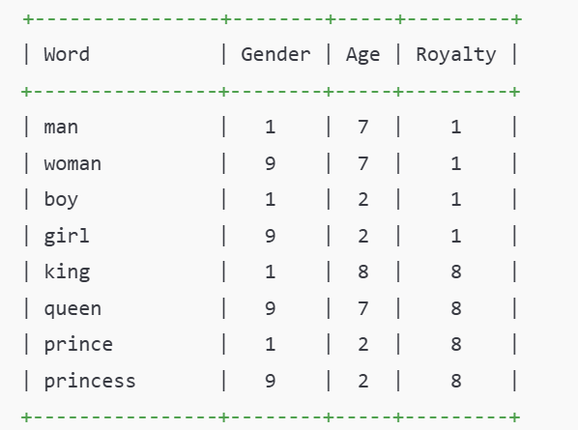
Let’s View Embeddings in 3D Space!
Let’s now look at the words “king,” “queen,” “prince,” and “princess.”
While these words share similar gender & age attributes with “man,” “woman,” “boy,” and “girl,” they have different meanings.
To distinguish “man” from “king,” “woman” from “queen,” we need to introduce a new semantic feature that sets them apart. We’ll call this feature “Royalty”. Let’s view them in a 3D space.
© All rights reserved for Dr. Ryan Ahmed @Stemplicity Inc.

Slide 14
Thank you!

